Slide 1
Inflation Report August 2019
Costs and prices

Slide 2
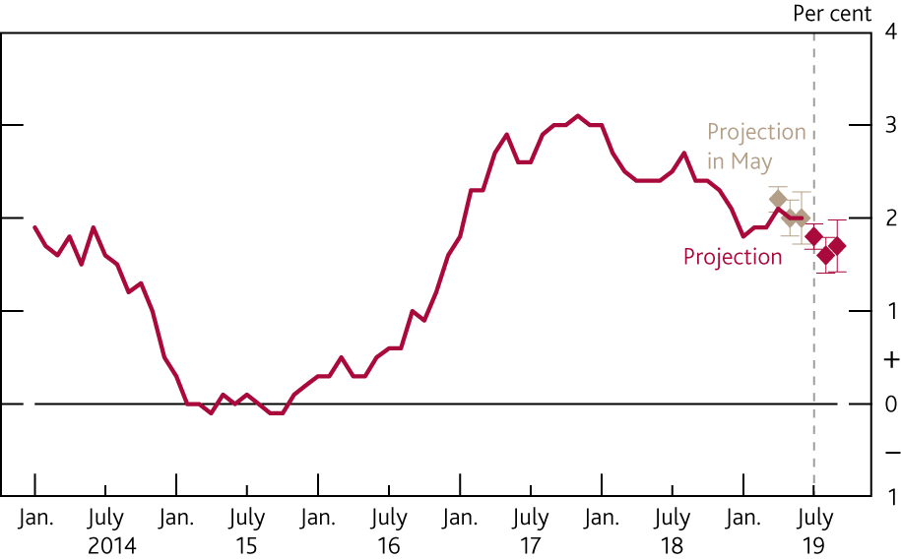
Chart 4.1 CPI inflation is expected to fall below the 2% target in the coming months
CPI inflation and Bank staff’s near-term projection^{(a)}
Sources: ONS and Bank calculations.
(a) The beige diamonds show Bank staff’s central projection for CPI inflation in April, May and June2019 at the time of the May 2019 Inflation Report. The red diamonds show the current staff projection for July, August and September 2019. The bands on each side of the diamonds show the root mean squared error of the projections for CPI inflation one, two and three months ahead made since 2004.

Slide 3
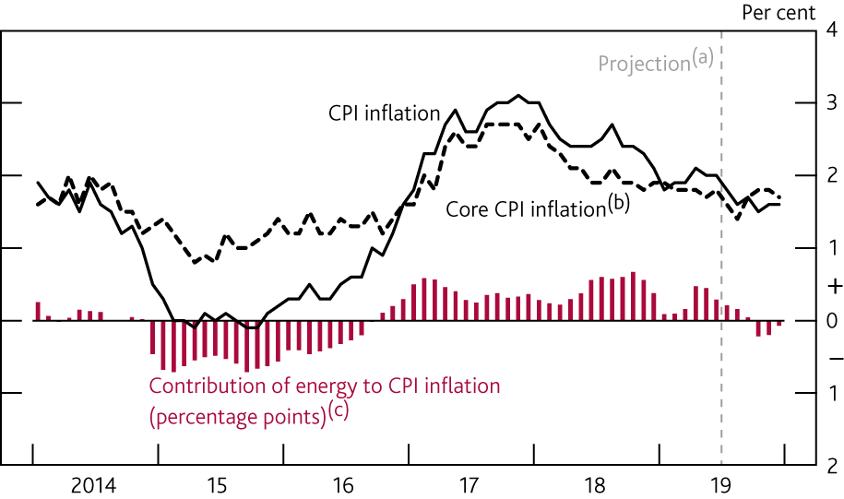
Chart 4.2 Energy prices are expected to drag on CPI inflation in 2019 H2
CPI inflation, core CPI inflation and the contribution of energy
Sources: Bloomberg Finance L.P., Department for Business, Energy and Industrial Strategy, ONS and Bank calculations.
(a) Bank staff’s projection. Fuels and lubricants estimates use Department for Business, Energy and Industrial Strategy petrol price data for July 2019 and are then based on the sterling oil futures curve.
(b) CPI inflation excluding food, energy, alcohol, tobacco and non-alcoholic beverages.
(c) Contribution of fuels and lubricants and electricity, gas and other fuels to annual CPI inflation.

Slide 4
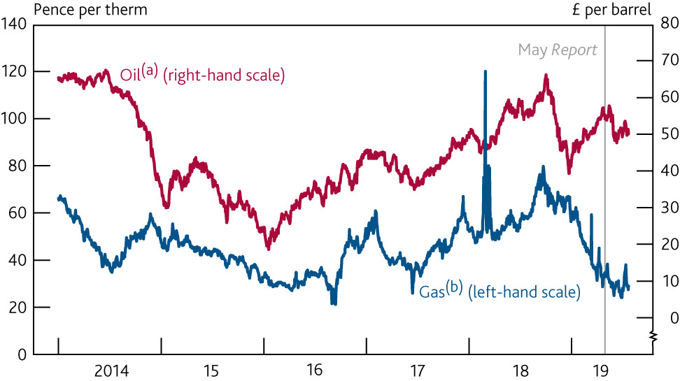
Chart 4.3 Sterling oil prices and wholesale gas prices have fallen since May
Sterling oil and wholesale gas prices
Sources: Bloomberg Finance L.P., Eikon from Refinitiv and Bank calculations.
(a) US dollar Brent forward prices for delivery in 10–25 days’ time converted into sterling.
(b) One-day forward price of UK natural gas.

Slide 5
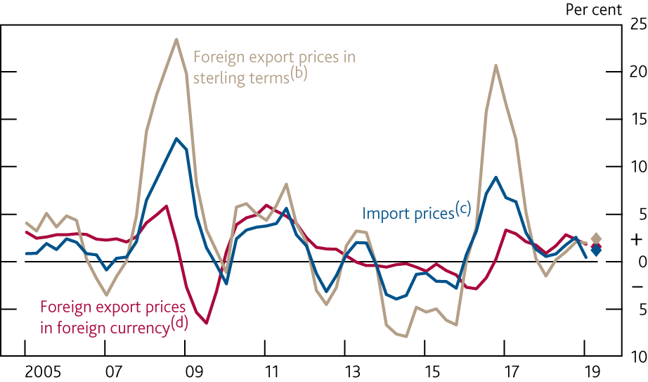
Chart 4.4 Import price inflation was close to zero in the year
to Q1
Import prices and foreign export price inflation^{(a)}
Sources: Bank of England, CEIC, Eikon from Refinitiv, Eurostat, ONS and Bank calculations.
(a) The diamonds show Bank staff’s projections for 2019 Q2.
(b) Domestic currency non-oil export prices as defined in footnote (d), divided by the sterling effective exchange rate index.
(c) UK goods and services import deflator excluding fuels and the impact of MTIC fraud.
(d) Domestic currency non-oil export prices of goods and services of 51 countries weighted according to their shares in UK imports. The sample excludes major oil exporters.

Slide 6
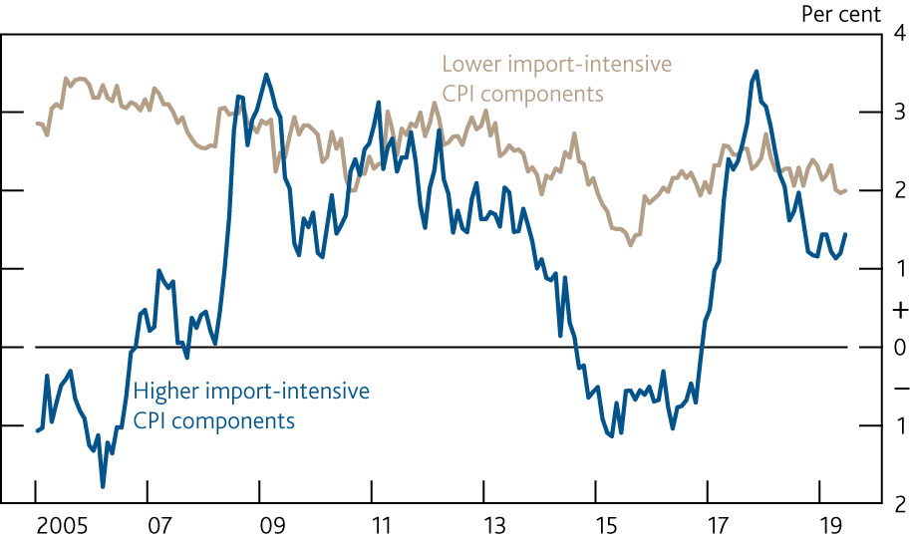
Chart 4.5 Inflation among import-intensive components has
fallen back from its 2017 peak
CPI inflation by import intensity^{(a)}
Sources: ONS and Bank calculations.
(a) Higher and lower import-intensive CPI components are the top and bottom half respectively of CPI components ordered by import intensity. Data exclude fuel and administered and regulated prices and are adjusted by Bank staff for changes in the rate of VAT, although there is uncertainty around the precise impact of those changes. Import intensities are ONS estimates of the percentage total contribution of imports to final household consumption in the CPI, by COICOP class, based on the United Kingdom Input-Output Analytical Tables 2014.

Slide 7
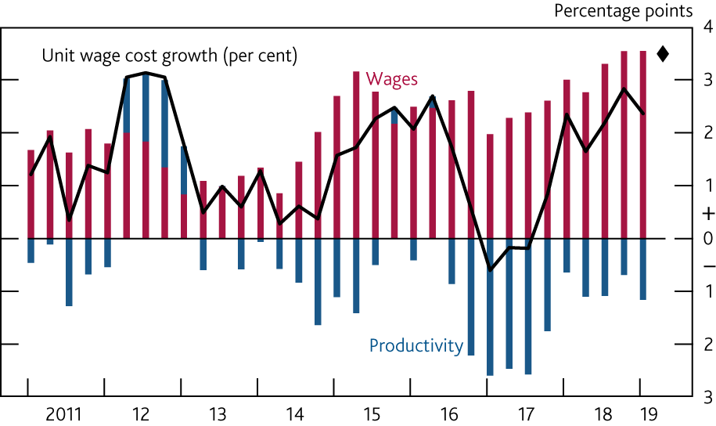
Chart 4.6 Unit labour cost growth has strengthened in recent
years
Contributions to four-quarter private sector unit wage cost growth^{(a)}
Sources: ONS and Bank calculations.
(a) Private sector AWE regular pay divided by private sector productivity per head, based on the backcast for the final estimate of private sector output. The diamond shows Bank staff’s projection for 2019 Q2. See Table 4.C in the November 2018 Inflation Report for more details.

Slide 8
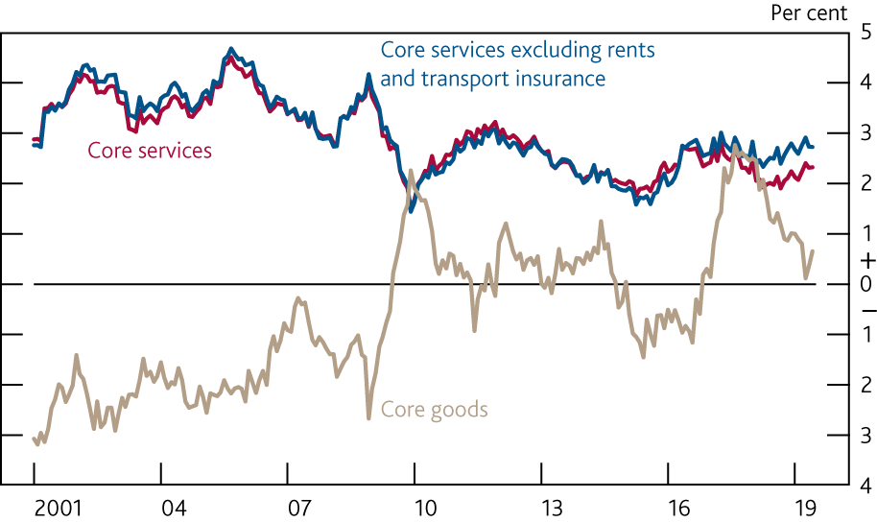
Chart 4.7 Core services price inflation remains low by historical standards
Core goods and core services CPI inflation^{(a)}
Sources: ONS and Bank calculations.
(a) Core services CPI excludes airfares, package holidays, education and VAT. Core goods CPI excludes food, non-alcoholic beverages, alcohol, tobacco, energy and VAT. Where Bank staff have adjusted for the rate of VAT there is uncertainty around the precise impact of those changes.

Slide 9
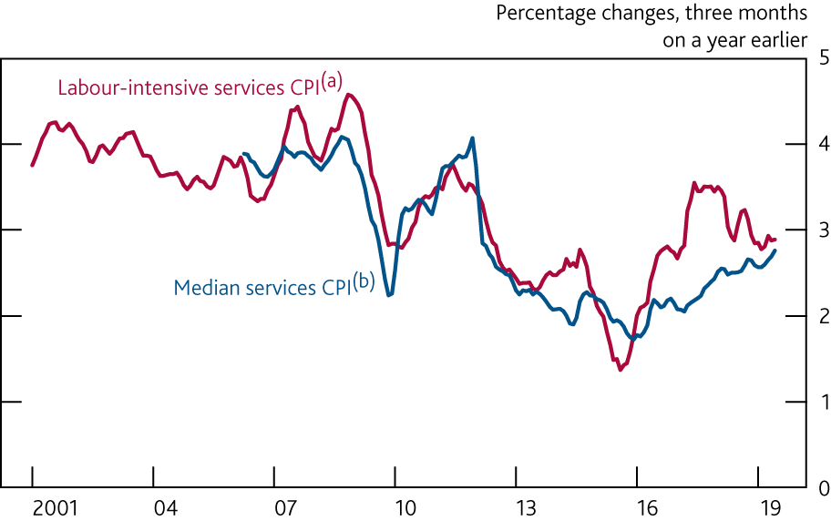
Chart 4.8 Price-based indicators of DGI have picked up
since 2015
Indicators of domestically generated inflation
Sources: ONS and Bank calculations.
(a) Labour-intensive services CPI contains the top 15 components of core services CPI by labour content, assessed using the United Kingdom Input-Output Analytical Tables 2014. Data are adjusted by Bank staff for changes in the rate of VAT, although there is uncertainty about the precise impact of those changes.
(b) The median annual inflation rate of around 190 services items in the CPI basket. These data have not been adjusted for changes in the rate of VAT.

Slide 10
Tables

Slide 11
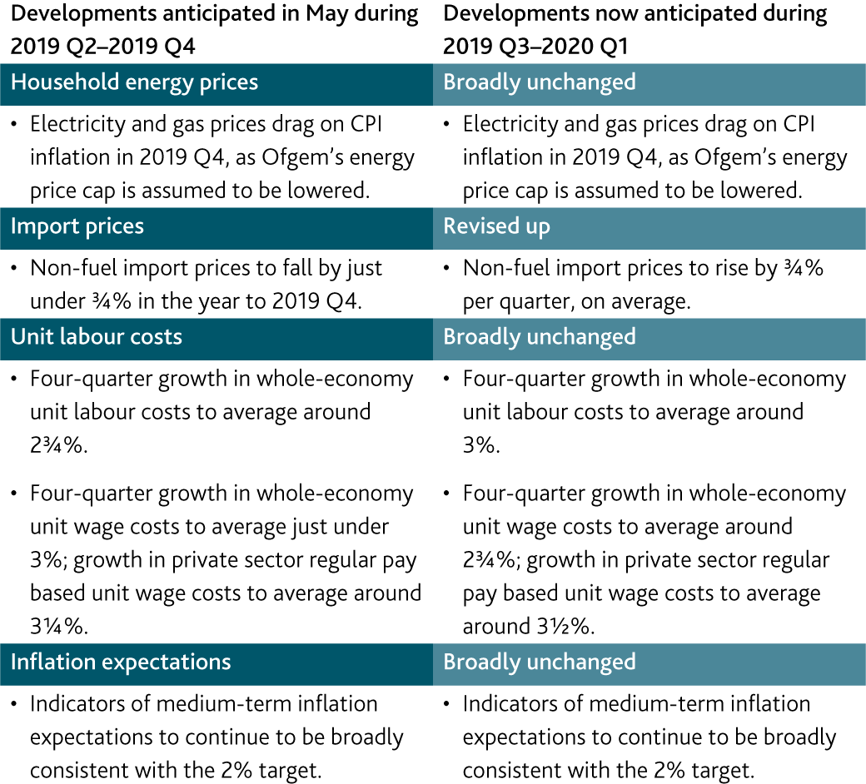
Table 4.A Monitoring the MPC’s key judgements

Slide 12
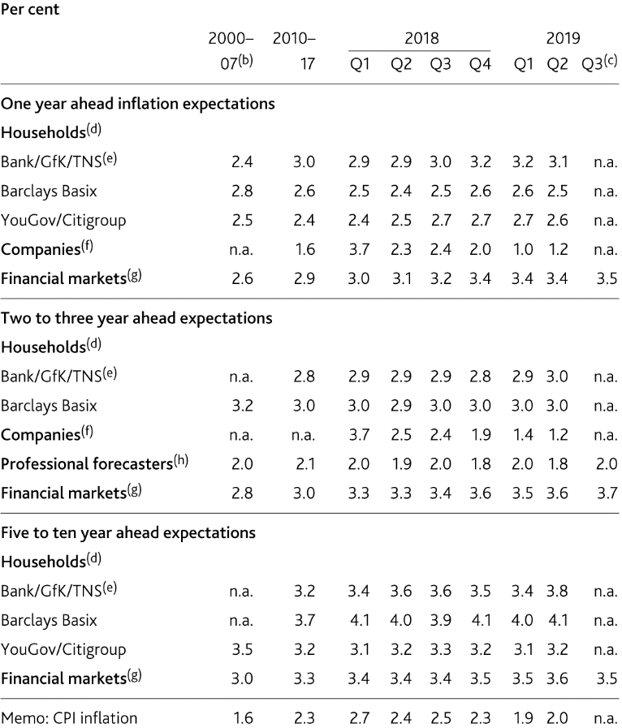
Table 4.B Financial market measures of inflation expectations are elevated, but households’ expectations are generally close to their post-crisis averages
Indicators of inflation expectations^{(a)}
Sources: Bank of England, Barclays Capital, Bloomberg Finance L.P., CBI (all rights reserved), Citigroup, GfK, ONS, TNS, YouGov and Bank calculations.
(a) Data are not seasonally adjusted.
(b) Averages from 2000, or start of series, to 2007. Financial market data start in October 2004, YouGov/Citigroup data start in November 2005 and professional forecasters data start in 2006 Q2.
(c) Financial market data are averages to 24 July 2019.
(d) The household surveys ask about expected changes in prices but do not reference a specific price index. The measures are based on the median estimated price change.
(e) In 2016 Q1, the survey provider changed from GfK to TNS.
(f) CBI data for the distributive trades sector. Companies are asked about the expected percentage price change over the coming 12 months and the following 12 months in the markets in which they compete. The 2018 Q1 data point was pushed up significantly by one response.
(g) Instantaneous RPI inflation one and three years ahead and five-year RPI inflation five years ahead, implied from swaps.
(h) Bank’s survey of external forecasters, inflation rate three years ahead.

Slide 13
Box 5
The assumptions for energy prices in the
MPC’s projections

Slide 14
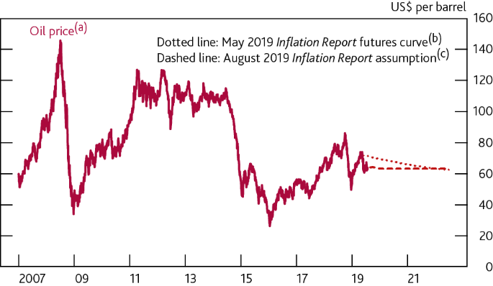
Chart A The MPC now assumes that oil prices will be unchanged over the forecast after two quarters
Assumptions about oil prices in the May and August Inflation Reports
Sources: Bank of England, Bloomberg Finance L.P., Eikon from Refinitiv and Bank calculations.
(a) US dollar Brent forward prices for delivery in 10–25 days’ time.
(b) Fifteen working day average to 24 April 2019.
(c) Based on monthly Brent futures prices for two quarters, then held flat. Fifteen working day average to 24 July 2019.

